Slide 1




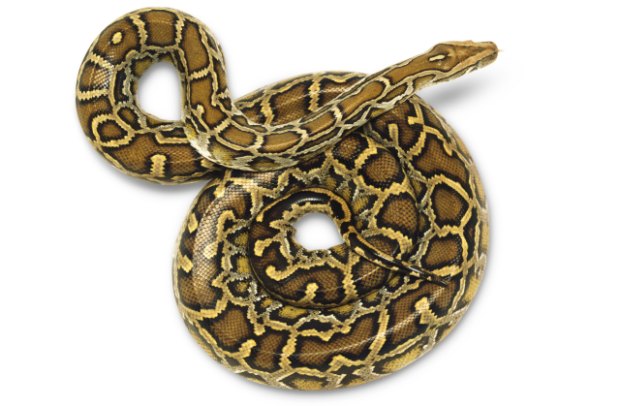
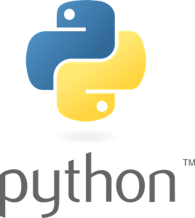

FUNCTION
LECTURE 7:
EXPLORE THE DEPTH

Slide 2





OBJECTIVE
HOW TO DEFINE A FUNCTION
HOW TO CALL A FUNCTION
FUNCTION ARGUMENTS
FUNCTION RECURSION

Slide 3


FUNCTION
FUNCTION IS A GROUP OF RELATED STATEMENTS THAT PERFORM A SPECIFIC TASK
FUNCTIONS HELP BREAK OUR PROGRAM INTO SMALLER AND MODULAR CHUCKS

Slide 4




DEFINING FUNCTION
def marks the start of function
function name to uniquely identify a function.
def function_name (parameter) :
Argument to pass a value in function
colon(:) to mark end of
function header

Slide 5


EXAMPLE OF FUNCTION
def greet (name):
print(“Hello,” + name +” . Good afternoon!”)

Slide 6


CALLING A FUNCTION
HOW TO CALL A FUNCTION?
Once we have defined a function, we can call it from another function, program or even the Python prompt.
To call a function we simply type the function name with appropriate parameters.
>>> greet(“everyone")
>>>Hello, everyone. Good afternoon!

Slide 7


EXAMPLE
def my_func(): x = 10
global y y = 20
print("Value of y inside function:",x) print("Value of y inside function:",y)
x = 20
y = 10
my_func()
print("Value of y outside function:",x) print("Value of y outside function:",y)

Slide 8

Types of function
THERE ARE TWO TYPES OF FUNCTION IN PYTHON
BUILT-IN FUNCTION
Example: print(), input(), eval().
USERDEFINE FUNCTION
Example: def my_addition(x,y):
sum = x+y
return sum

Slide 9


BUILT-IN FUNCTION
FUNCTION BUILT WITHIN THE PYTHON.
THERE ARE 68 BUILT-IN FUNCTION VERSION 3.4.
CHANGES WITH RESPECT TO UPDATED VERSION.

Slide 10









DEFAULT ARGUMENT
FUNCTION ARGUMENTS
VARIABLE FUNCTION ARGUMENTS
ARBITRARY ARGUMENTS
KEYWORD ARGUMENT

Slide 11



DEFAULT ARGUMENTS
Default value to function argument is passed using assignment operator ‘ = ‘.
Example:
def greet(name, msg = "Good morning!"): print("Hello, " name + ', ' + msg)
Non-default argument cannot follow default argument
Example: def greet(msg = "Good morning!", name):
SyntaxError:
non-default argument follows default argument

Slide 12


KEYWORD ARGUMENTS
When we call a function with some values, these values get assigned to the arguments according to their position .
Keyword arguments follows positional argument.

Slide 13



EXAMPLE OF KEYWORD ARGUMENT
greet(name = "Bruce",msg = "How do you do?")
2 keyword arguments
greet(msg = "How do you do?",name = "Bruce")
2 keyword arguments (out of order)
greet("Bruce",msg = "How do you do?")
1 positional, 1 keyword argument
greet(name="Bruce","How do you do?")
SyntaxError:
non-keyword arg after keyword arg

Slide 14


ARBITRARY ARGUMENTS
If number of arguments unknown we use arbitrary arguments
( * ) Asterisk before arguments define arbitrary arguments.
Example:
def greet(*names):
for name in names: print("Hello",name)
>>>greet("Monica","Luke","Steve","John")

Slide 15


 Like other programming language in python, function can call itself.
RECURSION FUNCTION
 Definition of recursion in python is same as other programming lang. -> C, C++, C#, Java etc.

Slide 16



EXAMPLE OF RECURSION
def recur_fact(x): if x == 1:
return 1
else:
return (x * recur_fact(x-1))
num = int(input("Enter a number: ")) if num >= 1:
print("The factorial of", num, "is", recur_fact(num))

Slide 17


ANONYMOUS FUNCTION
Function without function name.
Function is defined using lambda keyword, hence function is also called Lambda function.
Used for short period in python.
Can have any number of arguments but only single expression.
Specially used with built-in functions like filter(), map() etc.

Slide 18


EXAMPLE OF LAMBDA FUNCTION
 double = lambda x: x * 2 print(double(5))
 my_list = [1, 5, 4, 6, 8, 11, 3, 12]
new_list = list(filter(lambda x: (x%2 == 0) , my_list)) print(new_list)

